Slide 1
Dealing with textual data
Dealing with Data, Class 9

Slide 2
Announcements
Next time: your presentations!
Aim for 15-20 minutes; there will be extra time for questions.
Stanford Students: Course Evaluations now open on Axess!
Please fill them out!

Slide 3
Agenda
Intro: text as data
Examples:
Analyzing language at traffic stops
Polarization in political rhetoric
Word embeddings and what they can teach us about society
Recap of the whole quarter!

Slide 4
Introduction
Text as data

Slide 5
Text as data
Obviously, text is an important data source.
Example: ChatGPT
As usual, we can use text to train models.
Example: ChatGPT
It can often be hard to interpret the values we get on these models.
Example: ChatGPT
But! There are (simpler) models that we can interpret.
(Not large language models)

Slide 6
Today
Several examples of text as data that are interpretable
Interesting applications/findings
Racial disparity in policing
Political polarization over time
A history of bias in language
A few new techniques
New ways to use our old favorites (Regression, PCA)
Regularization
Word Embeddings

Slide 7
Example 1
Text from traffic stops

Slide 8
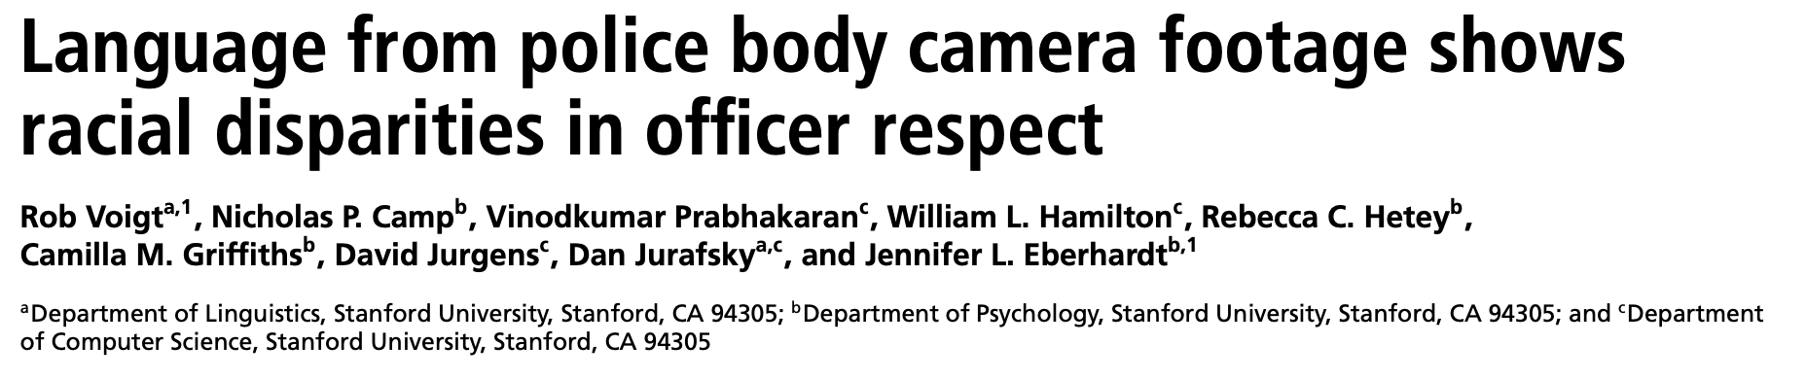

Slide 9
The question
Do US police officers treat Black and white community members differently?
In particular, is there a differing level of “respect”?
The challenge(s)
Regression
As usual, how do we establish causality?
“Because they were Black” is a hard thing to establish from data
How to quantify “respect”?
PCA/Regression/a linguistic model

Slide 10
The data
Dialogue of 981 traffic stops from April 2014 in Oakland, CA
Transcriptions of body-cam footage from Oakland PD
Leads to about 36,000 utterances
Volunteers rated 414 random utterances on:
Respectful
Polite
Friendly
Formal
Impartial
Note: they had multiple people rate each utterance to check for agreement.

Slide 11

Q0. How do we measure respect?
PCA! (Principle components analysis)
Collapse five questions into two
Utterances
Utterances
Respectful
Polite
Friendly
Formal
Impartial
.7
$$≈$$
How “polite” this utterance was
Call one of them “respect”
This one contains aspects of “respectful, polite, friendly, impartial”
Call the other “formality”
This one is mostly “formal”

Slide 12
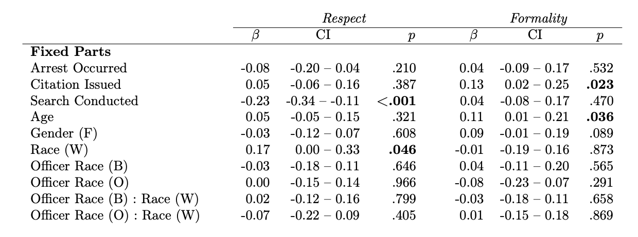
Q1. How does “respect/formality” differ by race? in the human-tagged data?
Run a regression!
Statistically significant results:
Less respectful if a search was conducted
More respectful if white
More formal if citation was issued
More formal if older
Notes:
R^2 for respect is .358, R^2 for formality

Slide 13
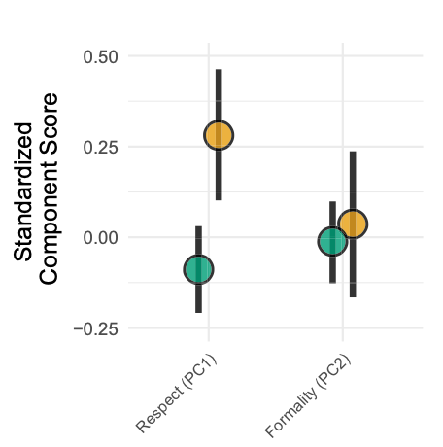
Q1. How does “respect/formality” differ by race? in the human-tagged data?
“Formality” is about the same for Black and white community members.
“Respect” is not.

Slide 14
Q2. How to quantify “respect,” part 2
Develop a model for language.
We can use this model to interpret findings about ”respectful” language
We can also use this model to tag more of the data.

Slide 15
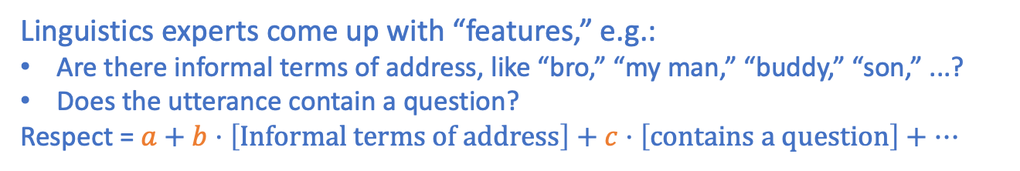
This paper’s model for language
What is the model?
When is it reasonable?
How do we fit the model?
How do we interpret the model once it is fit?
Linguistics experts come up with “features,” e.g.:
Are there informal terms of address, like “bro,” “my man,” “buddy,” “son,” ...?
Does the utterance contain a question?
Respect = $a+b⋅\left[Informal terms of address\right]+c⋅\left[contains a question\right]+⋯$
Linear model!
When we think a linear model of the world is reasonable, and when we trust our experts...
When it fits the data well (in this case, $R^{2}≈0.3$)
Regression!
If we believe that this is causal, we can train police officers to speak differently.
In any case, we can use it to take more data and cycle back to our earlier regression...

Slide 16
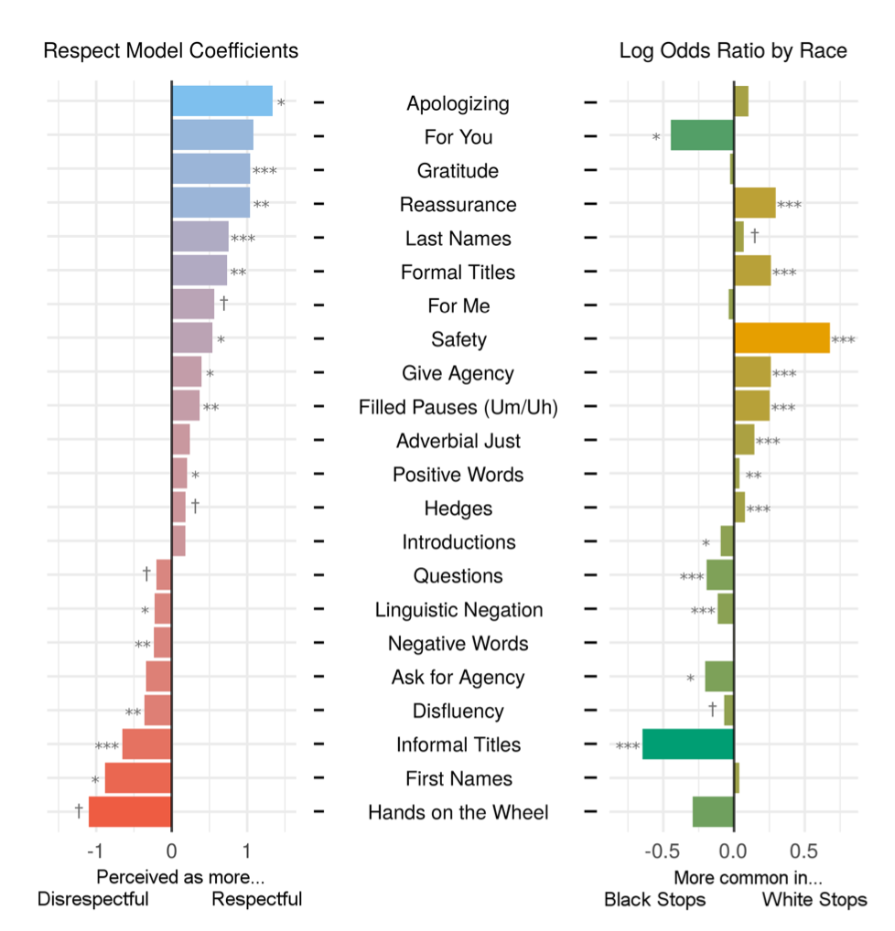
Q2. How to quantify “respect,” part 2
Running a regression yields:
If you believe the model, and want police officers to be more uniformly “respectful:”
Instruct them to apologize, say thank you, use last names and formal titles, express concern for person’s safety, ...
Instruct them to avoid phrases like “hands on the wheel”
Whether or not we believe the model, we now get a lot more tagged data...

Slide 17
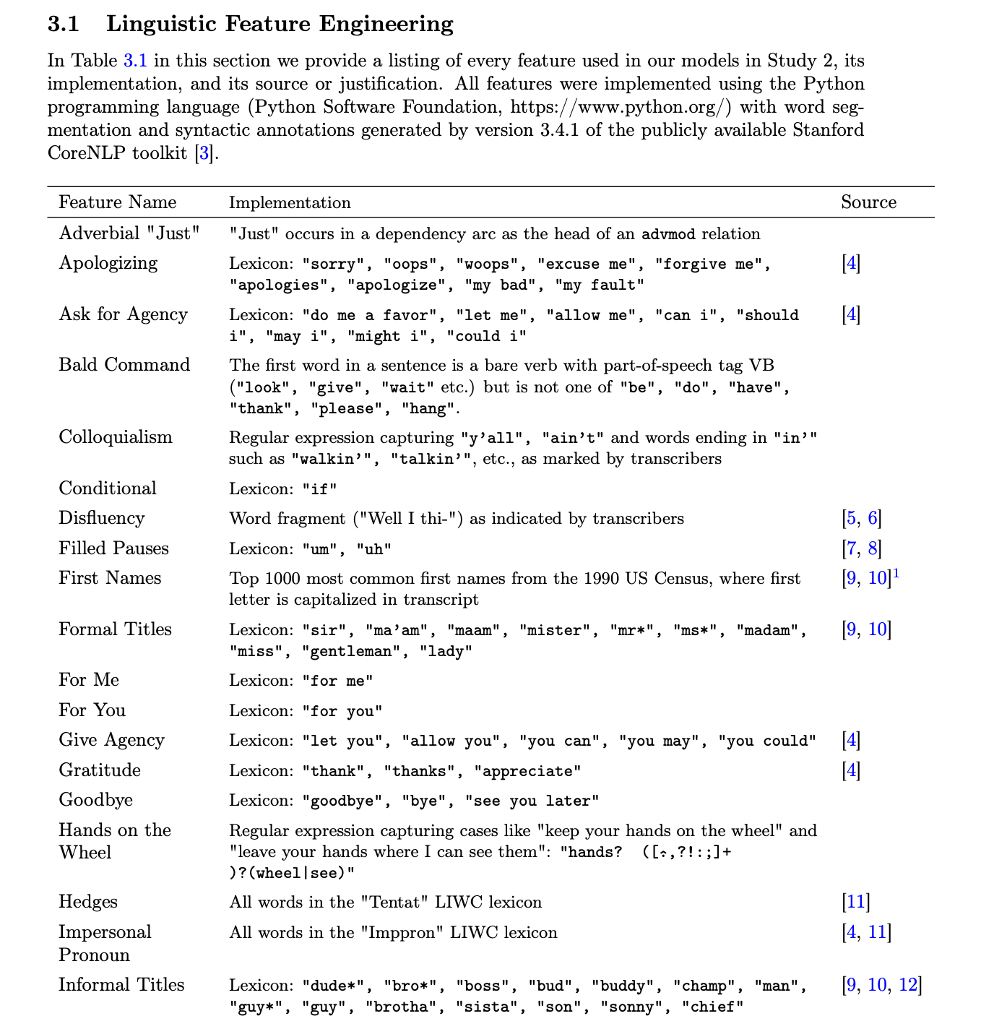
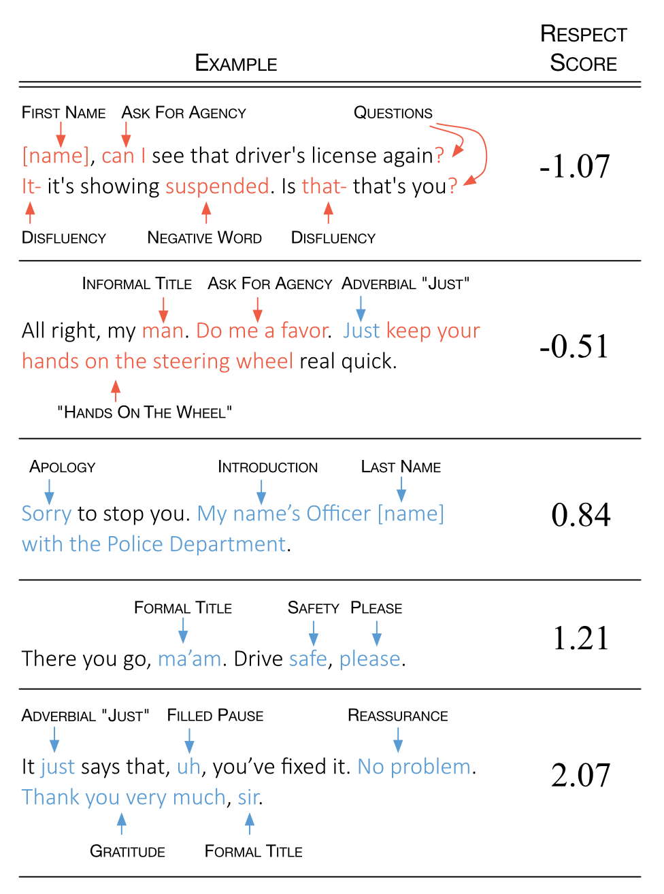
More info...

Slide 18
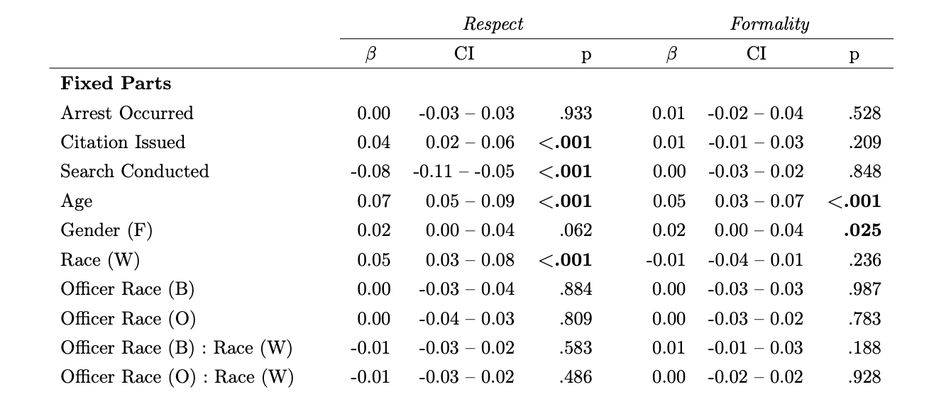
Do the regression again with the model-tagged data
More respectful if:
Citation issued
Search not conducted
Older
White
More formal if:
Older
Female
Relative to human-tagged data:
Similar results
Smaller p-values, lower R²

Slide 19
Take-aways
You can learn something from text just with our old friends, regression and PCA!
Police officers in Oakland seem to be less respectful towards Black community members.
Hopefully Oakland PD can use this analysis to help train their officers

Slide 20
Example 2
Measuring Polarization from Congressional Speech

Slide 21
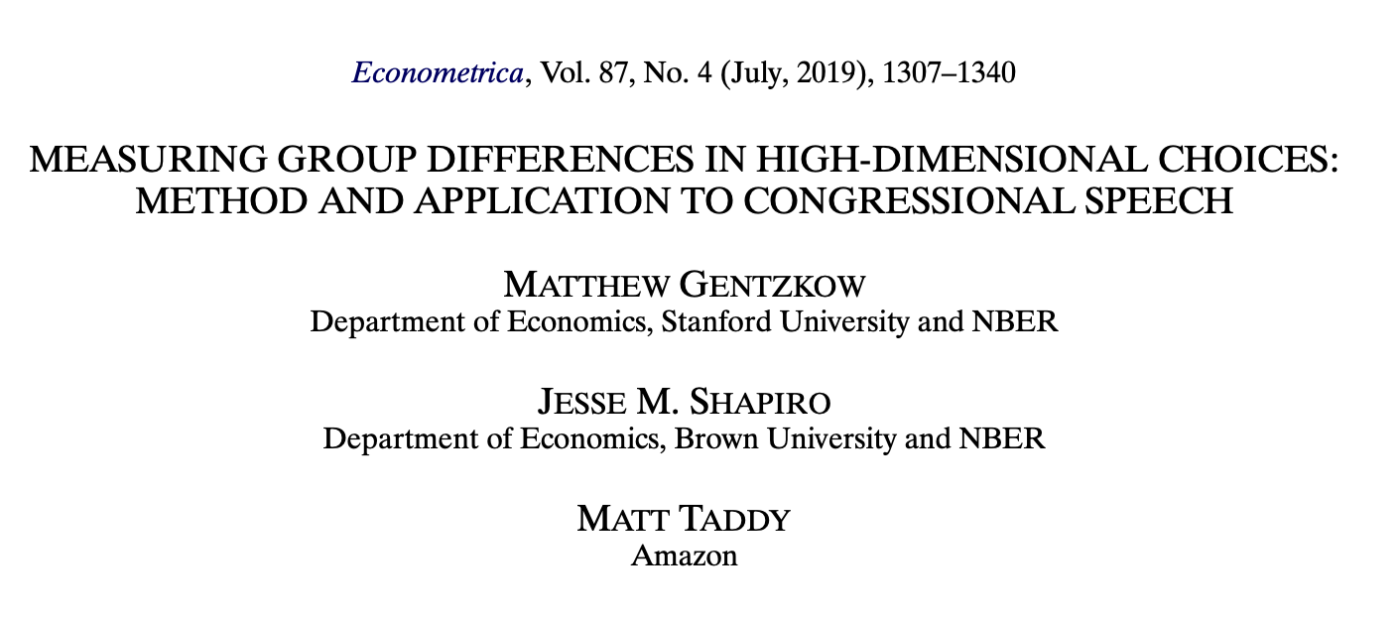

Slide 22


There are partisan differences in language
“Pro-abortion” vs. “Pro-choice”
“Death tax” vs. “Estate tax”
“Illegal immigrant” vs. “Undocumented worker”
In all these examples, both terms refer to the same thing!
But in the US, one is coded “Republican” and the other is coded “Democrat”

Slide 23
Question of this paper
Has language become more partisan over time?
Data of this paper
Congressional record (in the US Congress) from 1873 to 2016

Slide 24
Challenges “Has language become more partisan over time?”
Do we know of all of the examples?
In recent times, there are some famous ones (see previous slide), but maybe there are others?
In long-ago times, how do we know?
Maybe part of partisanship is in what you choose to talk about?
E.g., maybe “Apple Orchard” looks really partisan in the data, but only because Democrats talk about apples more than Republicans.
Return of overparameterization
There are tons of things that people can say, way more than there are people or observations...
E.g., maybe “Apple Orchard” looks really partisan, but only because only one person ever mentioned it in Congress and they happened to be a Democrat.

Slide 25
Idea
More precise question:
If I hear you speak in Congress for a minute, how well can I predict your party affiliation?
Develop a simple predictive model to predict party affiliation.
See if the predictive ability changes over time.

Slide 26
Model of language Distribution on bigrams
What is the model?
When is it reasonable?
How do we fit the model?
How do we interpret the model once it is fit?

Slide 27

What is the model? Bag-of-bigrams
Two bags of two-word phrases
A politician chooses two-word phrases out of their bag at random
Citrus Grove
Climate Change
Undocumented Worker
Undocumented Worker
Illegal Immigrant
Climate Change
American Dream
Climate Change American Dream Apple Orchard American Dream!
Undocumented Worker
Death Tax
American Dream
Death Tax
Apple Orchard
Estate Tax
Illegal Immigrant
Estate Tax
Illegal Immigrant
Estate Tax
Illegal Immigrant
Undocumented Worker
American Dream
American Dream
American Dream
American Dream
Politician

Slide 28
What is the model?
Each two-word phrase has a likelihood for each party
A politician picks words to say based on these likelihoods
Bigram | Likelihood Score
Illegal Immigrant | 80
Undocumented Worker | 10
Estate Tax | 32
Death Tax | 61
Apple Orchard | 1
American Dream | 95
Tax Cut | 62
Dream Estate | 3
...
Bigram | Likelihood score
Illegal Immigrant | 20
Undocumented Worker | 60
Estate Tax | 70
Death Tax | 0
Apple Orchard | 0
American Dream | 95
Tax Cut | 53
Dream Estate | 5
...
Climate Change American Dream Estate Tax Cut Undocumented Worker American Dream!
Politician

Slide 29
When is the model reasonable?
Not a great model for constructing coherent sentences...
Okay for capturing basic trends and doing prediction.
American Dream Illegal Immigrant Tax Cut Death Tax Cut American Dream Estate!

Slide 30
How do we fit the model?
First try: just record how often each phrase occurs in each party.
To predict: see which party’s table gives a better score.
Bigram | Likelihood score
Illegal Immigrant | 20
Undocumented Worker | 60
Estate Tax | 70
Death Tax | 0
Apple Orchard | 0
American Dream | 95
Tax Cut | 53
Dream Estate | 5
Climate Change | 30
The disparate impact of climate change is stifling the American Dream for undocumented workers!
+1
+1
Politician
+1

Slide 31
Issue: Overparameterization/Overfitting
There are tons of possible bigrams...it’s very likely that a few of them are said only once.
This person would be labeled as very likely a Democrat...
The disparate impact of climate change is stifling the American Dream for undocumented workers!
Also, did I tell you about the apple orchard?
Bigram | Likelihood score
Illegal Immigrant | 20
Undocumented Worker | 60
Estate Tax | 70
Death Tax | 0
Apple Orchard | 0
American Dream | 95
Tax Cut | 53
Dream Estate | 5
Climate Change | 30
Bigram | Likelihood Score
Illegal Immigrant | 80
Undocumented Worker | 10
Estate Tax | 32
Death Tax | 61
Apple Orchard | 0
American Dream | 95
Tax Cut | 62
Dream Estate | 3
Climate Change | 2
Illegal immigrants working in, say, apple orchards, are taking jobs from US citizens.
+1
Politician
Politician

Slide 32
Solution 1: Leave out self and rare bigrams
Restrict to bigrams that are:
used at least 100 times,
used in at least 10 unique speaker-sessions (of Congress),
used at least 10 times in one session
Leave my own speech out of the predictor.
E.g., say Politician A has a catchphrase that only a few people use.
Using that catchphrase puts a lot of emphasis on a little data.
Don’t include it when classifying Politician A.
Boom! Legistlate it up a notch!
Politician A

Slide 33
Solution 2: Regularization/Penalization
Give the estimator a “budget” for the number of bigrams it uses.
A bigram “costs” more if:
It appears rarely; or
It doesn’t give much signal about Democrat/Republican
Bigram | Likelihood score
Illegal Immigrant | 20
Undocumented Worker | 60
Estate Tax | 70
Death Tax | 0
Apple Orchard | 1
American Dream | 95
Tax Cut | 53
Dream Estate | 5
Climate Change | 30
Bigram | Likelihood Score
Illegal Immigrant | 80
Undocumented Worker | 10
Estate Tax | 32
Death Tax | 61
Apple Orchard | 0
American Dream | 95
Tax Cut | 62
Dream Estate | 3
Climate Change | 2
Eg. In this example:
”Apple Orchard” costs a lot to include because it is so rare.
“American Dream” costs a lot to include since both parties use it a lot.

Slide 34
How do we interpret the results?
We’re just looking for prediction!
Then we will interpret how predictive accuracy changes over time.

Slide 35

What are the results?
As a sanity-check, actually train two models:
Congressional speeches with correct labels
Congressional speeches with random labels
Bigram-Distribution Model fitting
Bigram-Distribution Model fitting
Actual Model
Garbage Model

Slide 36
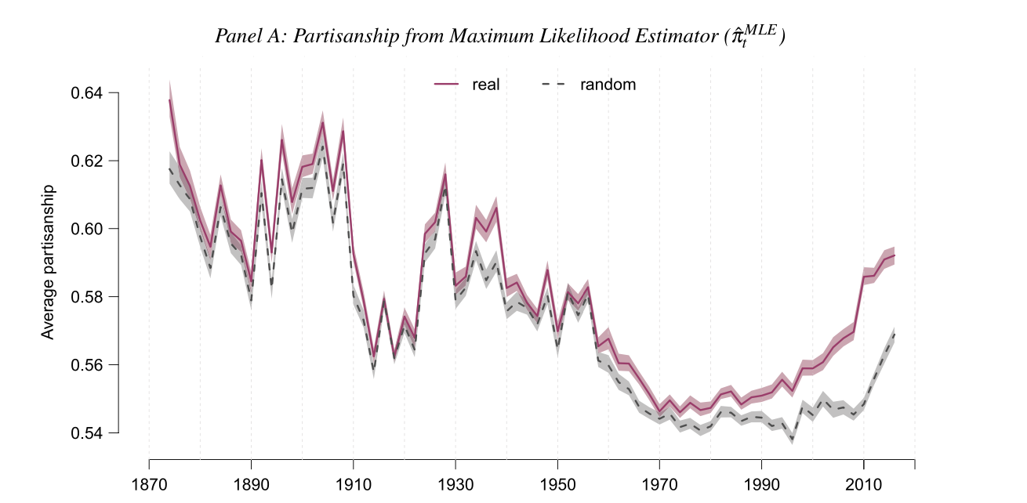
Without Either Solution Overparameterization/Overfitting is a concern...
If we didn’t look at the garbage model, we might conclude that there was a U-shaped thing going on...
...but looks like an artifact of overparameterization.
Actual Model
Garbage Model

Slide 37
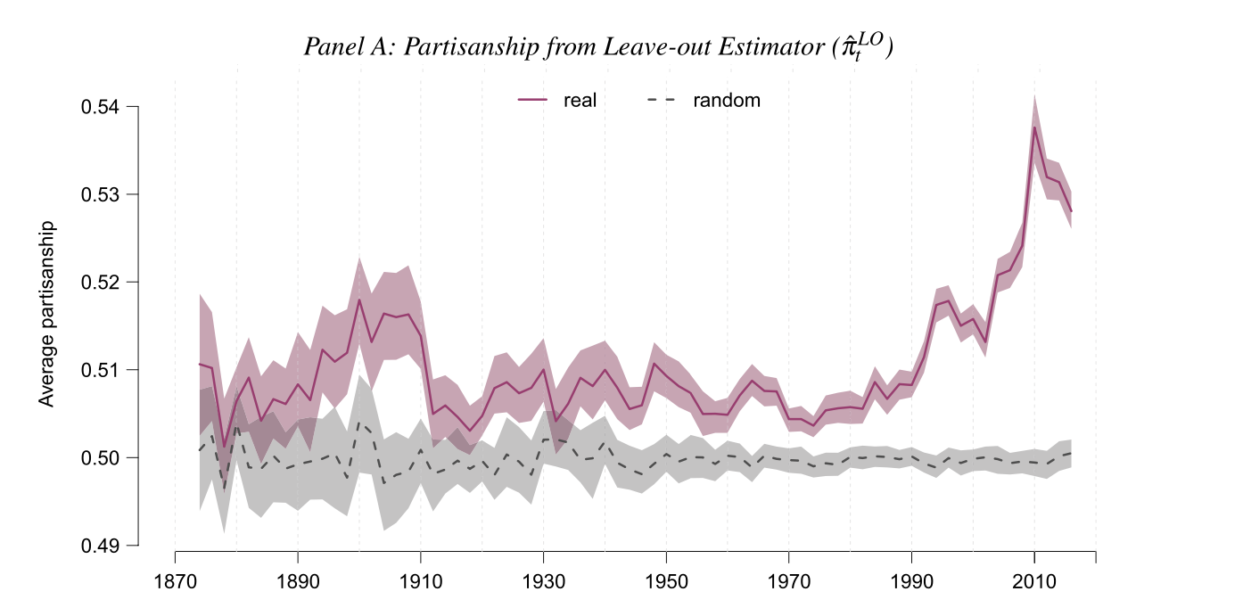
With Solution 1 (Leave out self)
Looks like “linguistic polarization” has an uptick starting in the 1990’s.
Actual Model
Garbage Model

Slide 38
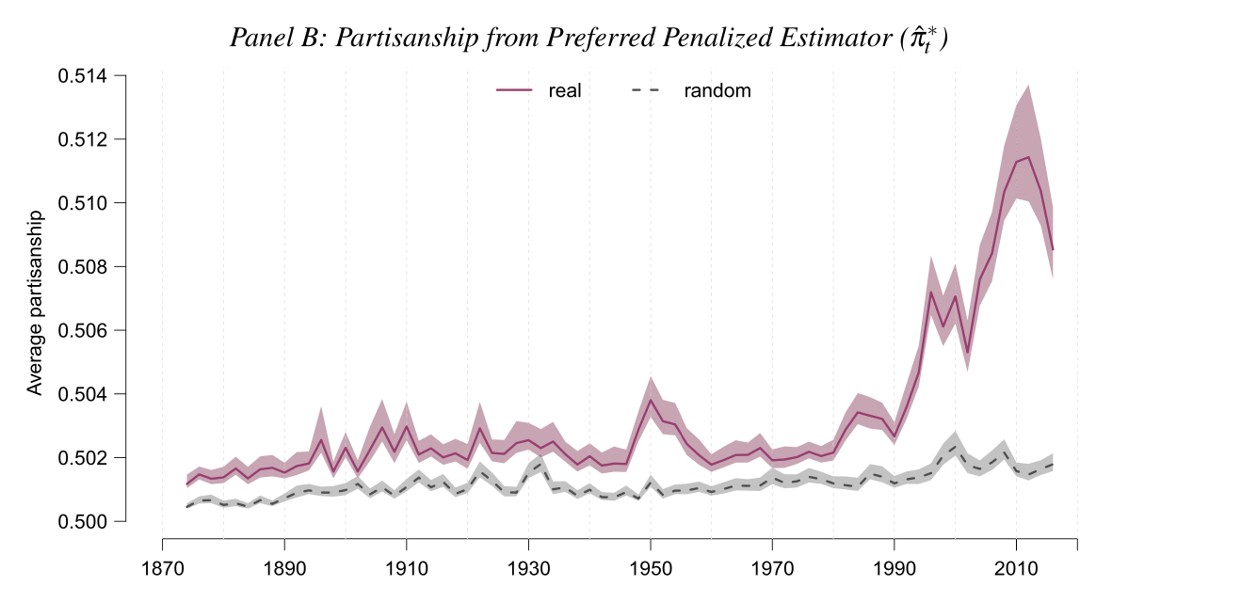
With Solution 2 (Regularization)
Looks like “linguistic polarization” has an uptick starting in the 1990’s.
Actual Model
Garbage Model

Slide 39
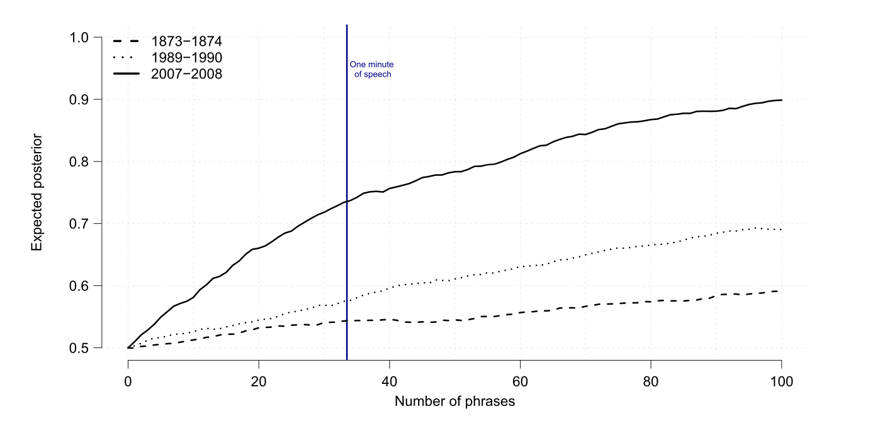
How accurately can you predict party affiliation after a minute?
2007-2008
1989-1990
1873-1874

Slide 40
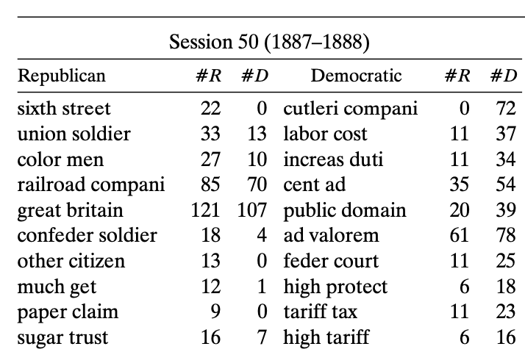
Okay, we said we weren’t going to interpret the model, but...
It is kind of interesting to look at the most informative bigrams by era
Post-Civil War Issues
Tariff Stuff
1887-1888

Slide 41
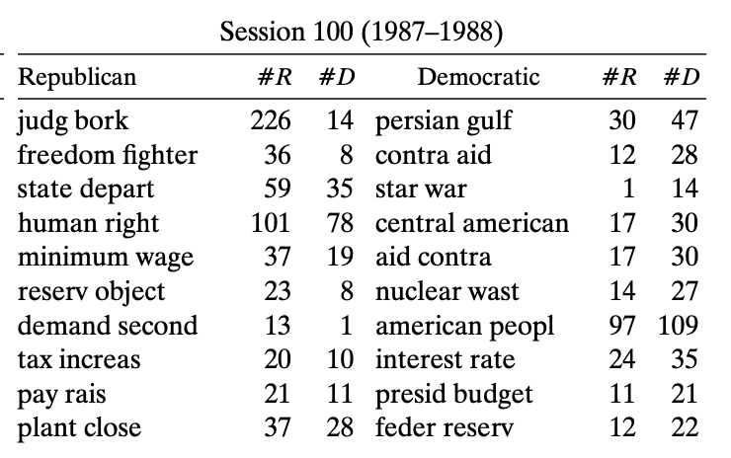
Okay, we said we weren’t going to interpret the model, but...
It is kind of interesting to look at the most informative bigrams by era
Bork was a Republican nominee for Supreme Court who was voted down
Contra Aid was a complicated scheme to fund “freedom fighters” in Nicaragua with arms sales to Iran (which was illegal)
1987-1988

Slide 42
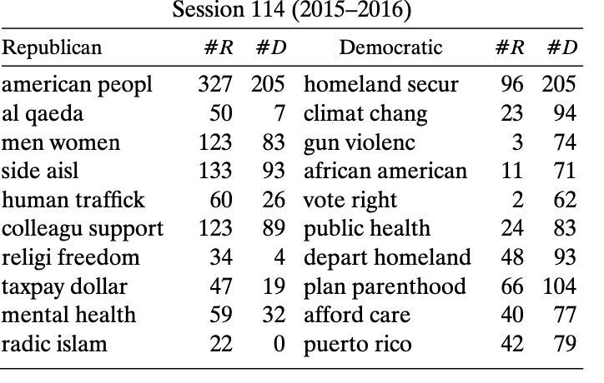
Okay, we said we weren’t going to interpret the model, but...
It is kind of interesting to look at the most informative bigrams by era
Republican-coded issues:
“Radical Islam”
“Al Qaeda”
“Religious Freedom”
Democrat-coded issues:
“Climate Change”
“Affordable Care”
“Gun Violence”
2015-2016

Slide 43
Take-Aways from this example
The “distribution of bigrams” model isn’t a great model, but it does seem to have some predictive power.
Overparameterization is an issue, but isn’t that tricky to fix.
Polarization in Congressional speech seems to be up since the 90’s.

Slide 44
Example 3
Word Embeddings!

Slide 45
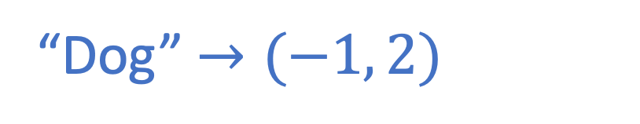
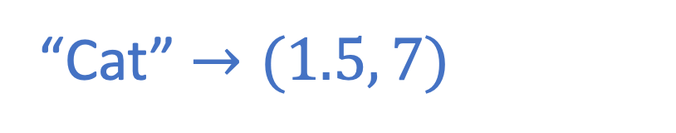
Word Embeddings: Overview
Turn words into lists of numbers.
This is useful if you want to, say, plug them into neural networks later.
Turns out, the geometry of the lists of numbers says something interesting about the words...
More soon!
“Cat” $→(1.5, 7)$
“Dog” $→(−1, 2)$
Cat
Dog

Slide 46
“Word embeddings” as a model of language
What is the model?
When is it reasonable?
How do we fit the model?
How do we interpret the model once it is fit?

Slide 47
What is the model?
Each word gets a vector of numbers.
In modern models, about 300 numbers.
Similar to SVD, where each person/book got a vector of numbers.
We don’t know ahead of time what the numbers are supposed to represent, we just fit them.
We predict that two words are “similar” if they have similar vectors.

Slide 48
When is the model reasonable?
Not great at modeling context
Each word is ”vectorized” on its own
However, can be used as part of a more expressive model
Can be good at modeling relationships between words

Slide 49
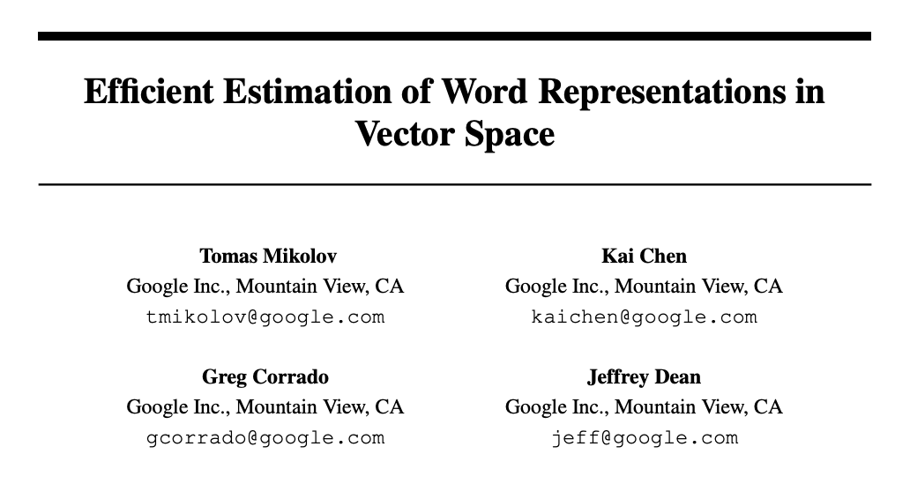
How do we fit the model?
Lots of ways to do it over the years
Extremely influential way: word2vec by a team at Google in 2013
Seems to work well [we’ll see more in a moment]
Fit the model using [Neural networks and other fancy stuff]

Slide 50
How do we interpret the model?
Let’s see...

Slide 51
The success of word2vec (word embeddings) Trained on the corpus of Google News
It can learn analogies!
France:Paris :: Italy:???
Einstein:scientist :: Messi:???
Japan: sushi :: Germany: bratwurst :: USA:???
Rome
Midfielder
Pizza

Slide 52
The success of word2vec (word embeddings) Trained on the corpus of Google News
France:Paris :: Italy:
Einstein:scientist :: Messi:
Japan: sushi :: Germany: bratwurst :: USA:
Rome
It can learn analogies! How?
Geometry!
The first pair gives you a direction and distance.
Go in that direction and distance starting from the prompt.
Midfielder
Pizza
Paris
France
Italy
Rome

Slide 53
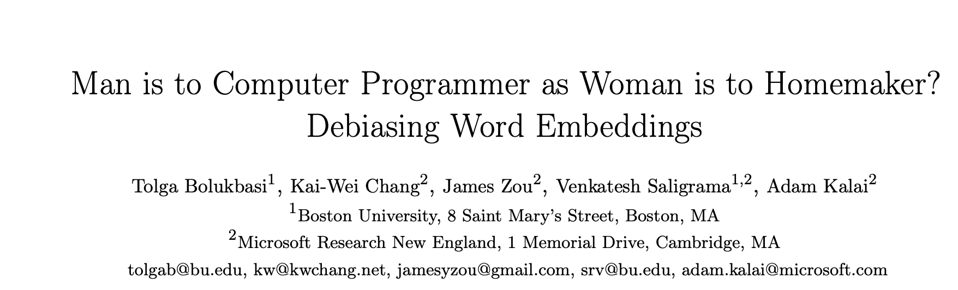
It can also learn problematic analogies

Slide 54
Examples
Man: woman :: computer programmer : ??? (homemaker)
He: pizza :: she : ??? (cupcake)
He: baseball :: she: ??? (softball)
He: affable :: she: ??? (charming)
He: burley :: she: ??? (blond)
He: pharmaceuticals :: she: ??? (cosmetics)

Slide 55
Why does it do this?
The model is trained on text that we as a society have generated
It reflects biases/stereotypes etc. that exist in society
We can thus use this to understand changes in biases/stereotypes over time (see next paper)
It is statistically accurate to say that women are more likely to be homemakers than men – but maybe we don’t want our algorithms to reflect these things back
The previous paper also has ideas for how to debias the predictions

Slide 56
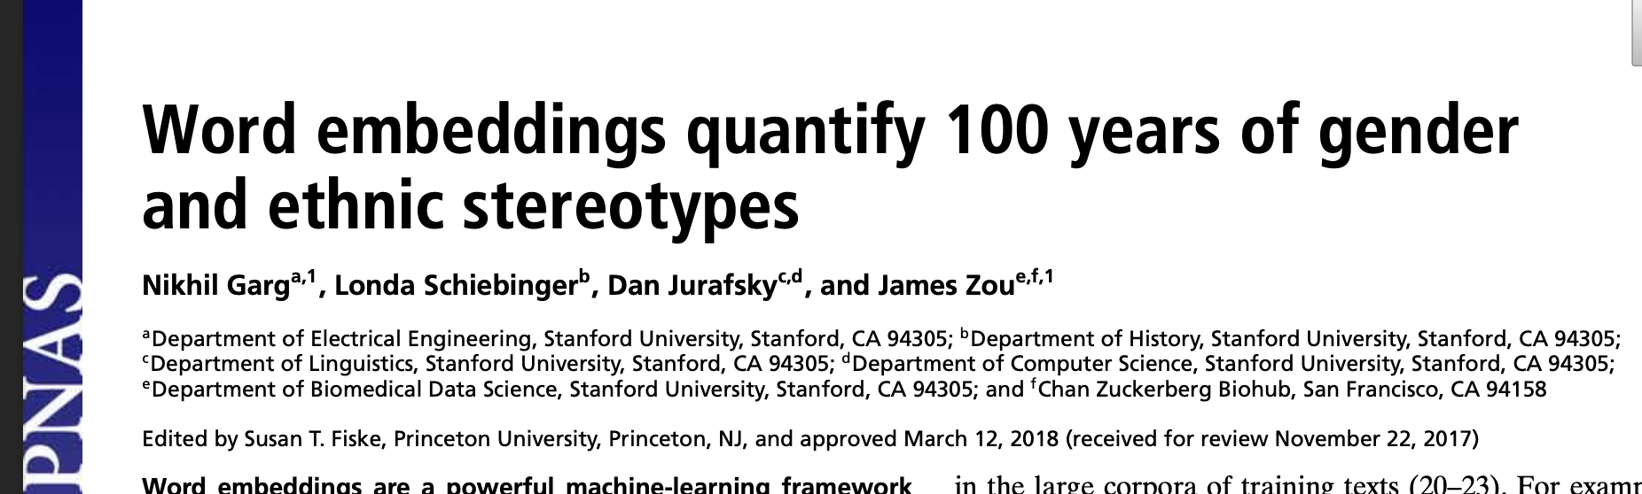

Slide 57
A question
To what extent do biases in language use reflect statistics?
Has this changed over time?

Slide 58
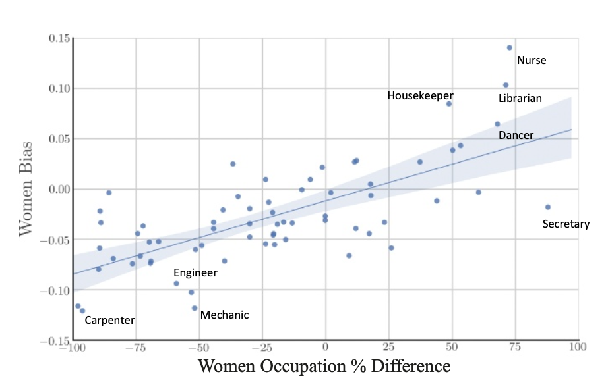
Modern data To what extent do biases in language use reflect statistics?
Profession coded as “more female” according to model
Take-away: the model is picking up on actual trends in employment.
(This may or may not be what we want)
Profession coded as “more male” according to model
Fewer women in that profession
More women in that profession

Slide 59
Repeat this exercise over history
Train model on historical text corpora
Compare to actual employment data (from census)
Aggregate over all professions to get two scores:
Occupational bias as measured by text of the day
Occupational bias as measured by census data
Plot both of these next to each other over time...

Slide 60
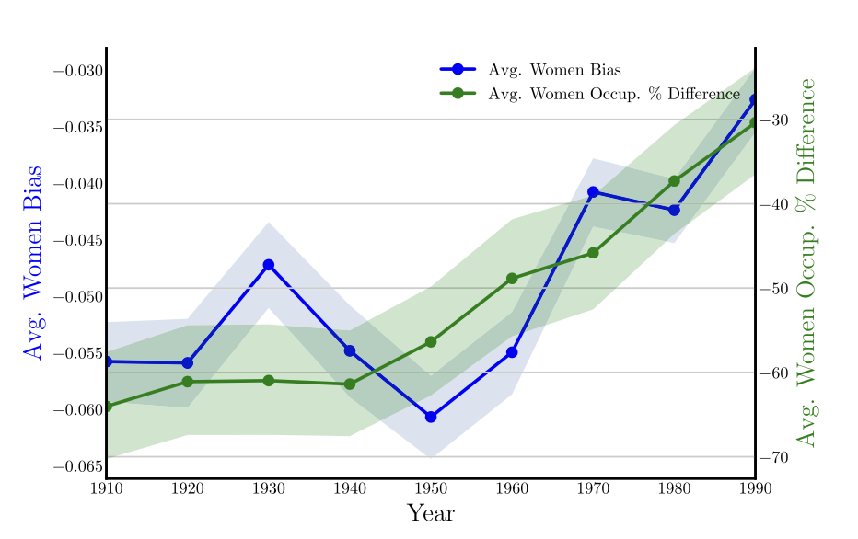
Repeat this exercise over history
In general, the ”gender gaps” in both measures have been closing over time.
They track each other a little bit...except when they don’t.
Occupational bias as measured by text of the day
Occupational bias as measured by census data

Slide 61
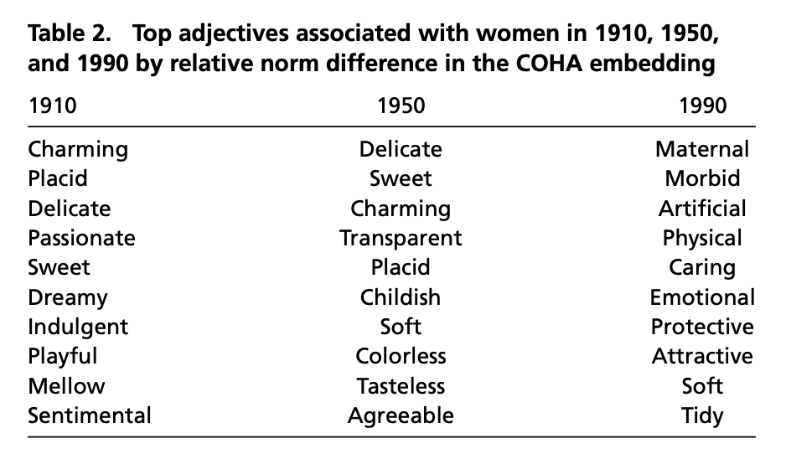
Bonus: Gendered language over time

Slide 62
Recap
Word Embeddings: Model words as lists of number.
The geometry of these embeddings have meaning!
They can do analogies!
Some of them seem problematic...
We can interpret/use this meaning!
Looking at how these analogies change over time can be interesting.
Can “correct” some of the problematic stuff

Slide 63
Recap of today: Text as (interpretable) data
Neural Networks/LLMs are great at text (e.g., ChatGPT), but not so interpretable.
However, there are some interpretable things we can do with text!
Regression/PCA with expert-defined linguistic features
bigrams and regularization
Word Embeddings

Slide 64
What just happened?
A real quick recap of the past 9 weeks

Slide 65


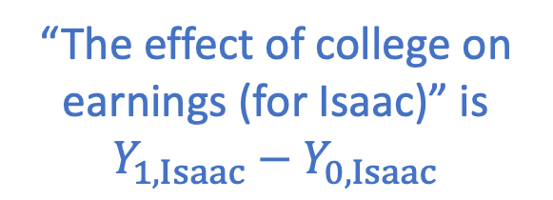


Causality
Not one obvious definition
For most of this class, we went with a counter-factual notion:
Earnings: $Y_{0,Isaac}$
Earnings: $Y_{1,Isaac}$
“The effect of college on earnings (for Isaac)” is $Y_{1,Isaac}−Y_{0,Isaac}$
College-Abstaining Isaac
College-Going Isaac

Slide 66
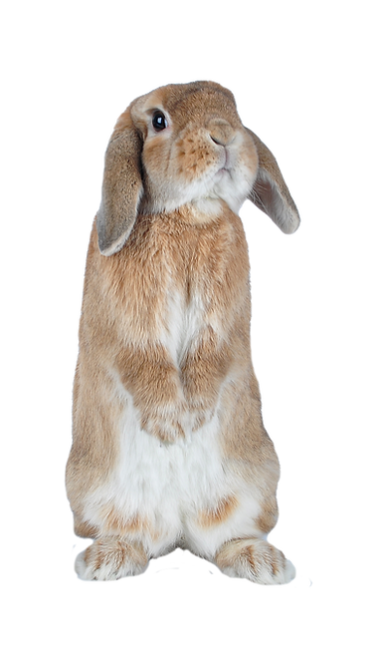




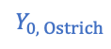
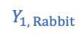
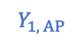
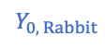
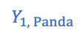
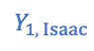
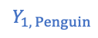
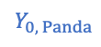
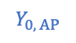
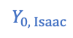
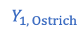
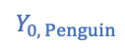
Establishing Causal Effects
This is hard to do from data, since we never see the counterfactuals!
What we can do: observational comparison.
Obs. Effect equals:
Average Treatment Effect
(what we want)
+
Effect of Selection on Levels
+
Effect of Selection on Treatment
Isaac
Panda
Rabbit
Ostrich
Penguin
Alien Penguin
$$Y_{0, Isaac}$$
$$Y_{0, Panda}$$
$$Y_{0, Rabbit}$$
$$Y_{0, Ostrich}$$
$$Y_{0, Penguin}$$
$$Y_{0, AP}$$
????
????
????
$10
$5
$6
$$Y_{1, Isaac}$$
$$Y_{1, Panda}$$
$$Y_{1, Rabbit}$$
$$Y_{1, Ostrich}$$
$$Y_{1, Penguin}$$
$$Y_{1, AP}$$
$10
$15
$11
????
????
????

Slide 67
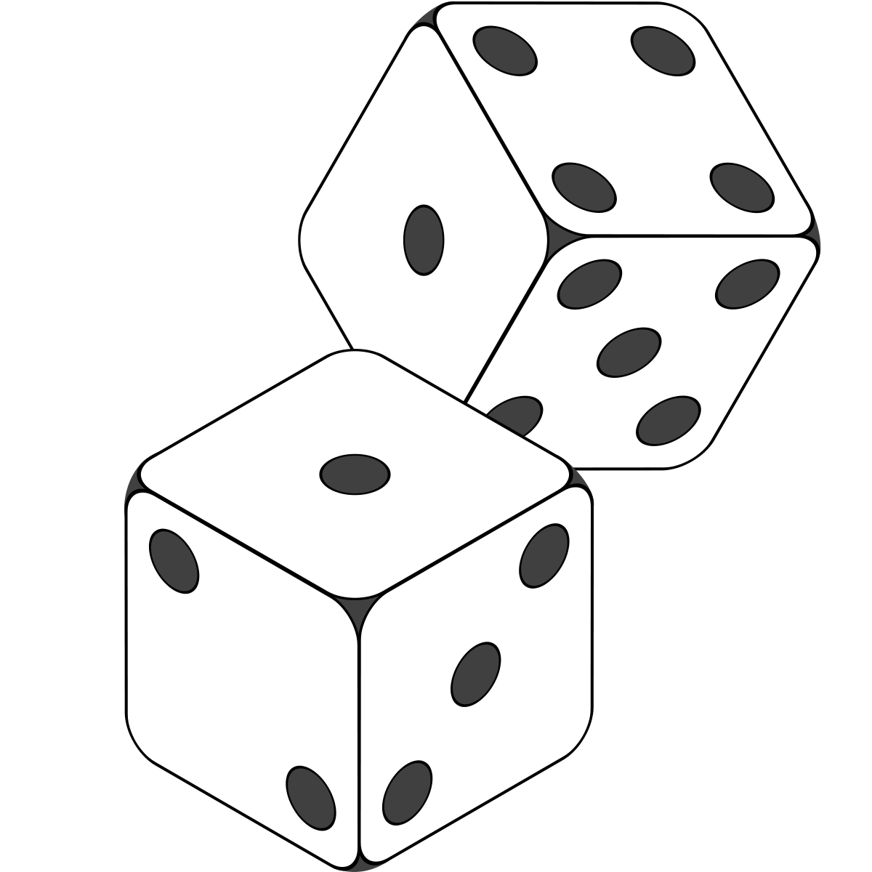
The Magic of RCTs
How do we make sure to avoid selection on levels/treatment?
Use randomness!
With a randomized control trial, we can learn about the world, even if we know nothing about the world!
Problem 1: Imperfect compliance
Problem 2: sometimes it’s not possible/ethical to do RCTs...

Slide 68



Problem 1: Imperfect Compliance Solution: LATE!
Four types of people:
Compliers, Always-Takers, Never-takers, Defiers.
If there are no Defiers:
Can use LATE (Local Average Treatment Effects) to learn the average treatment affect on the population of compliers.
Can also learn about this population.
Effect of
on
LATE $=$
Effect of
on
$$=$$
Effect of
on

Slide 69

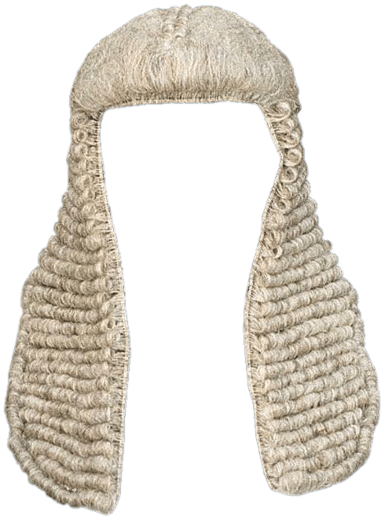
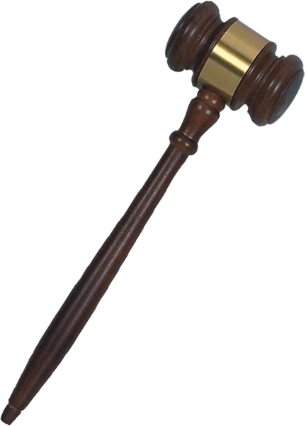
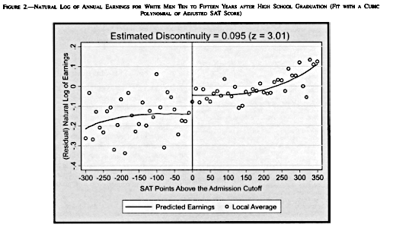
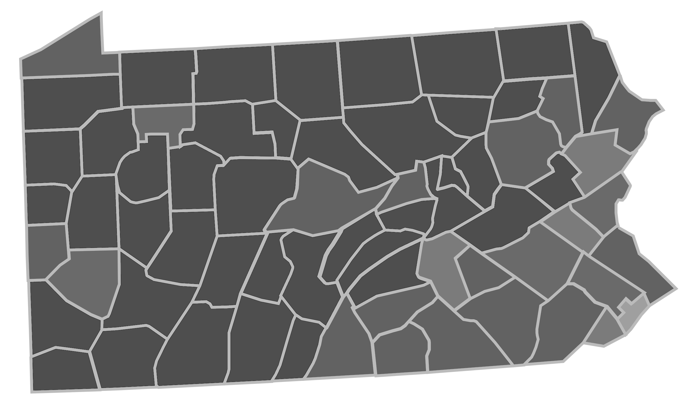
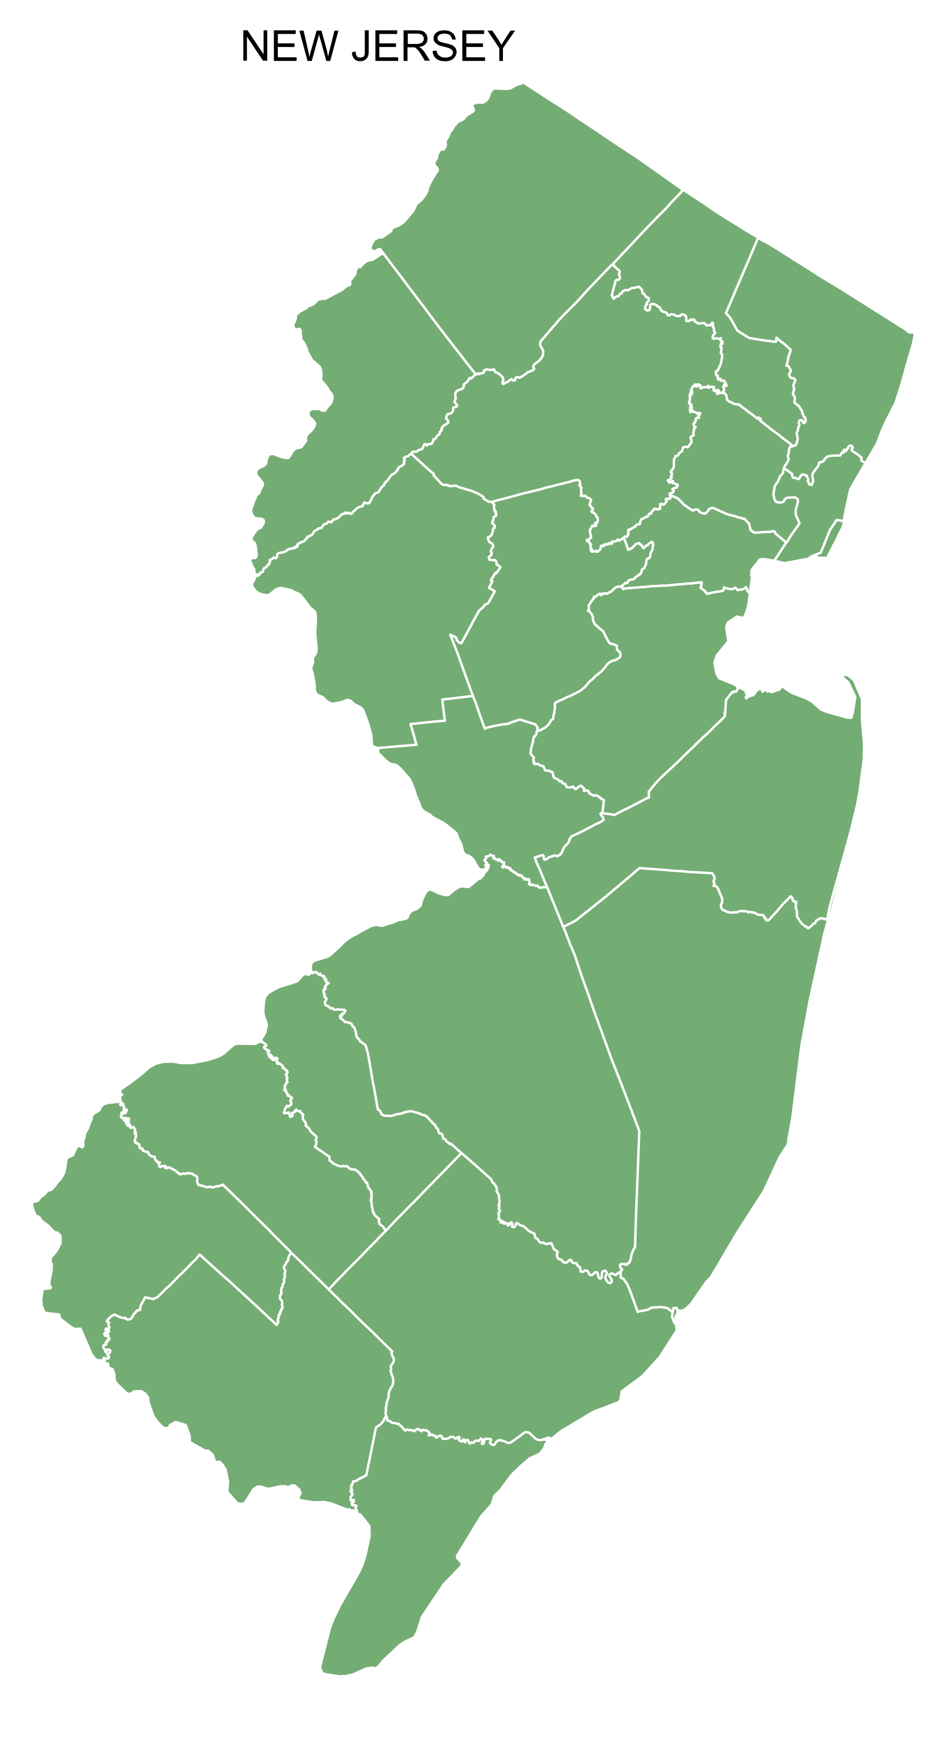
Problem 2: We can’t always run an RCT Solution: Natural Experiments!
Release 1
Release 1 and 2
Release them all!
Instrumental Variables:
Look for a “random enough” source of variation.
Should have: Relevance, Independence, Exclusion, and Monoticity
Example: random assignment to judges
Regression Discontinuity:
Look for a sharp cutoff
Example: Cut-off for college admissions
Difference-in-differences:
Look for policy changes between two nearby areas
See if there’s a difference in differences
Example: Minimum wage in NJ and PA
0.7
0.5
0.3
A
B
C
We’re raising the minimum wage!
New Jersey
(NJ)
Nah.
Pennsylvania (PA)

Slide 70



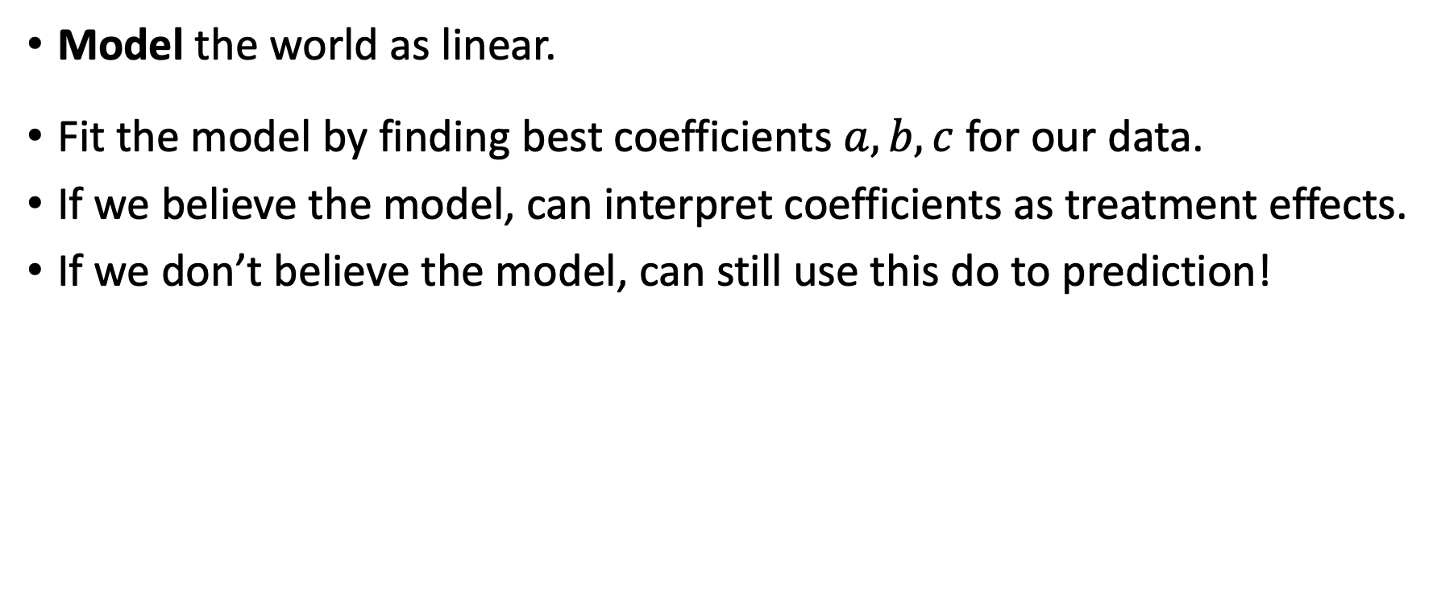

Another way to “Control” for things... Regression!
$$Y_{j}≈a+b⋅D_{j}+c⋅X_{j}$$
Model the world as linear.
Fit the model by finding best coefficients $a,b,c$ for our data.
If we believe the model, can interpret coefficients as treatment effects.
If we don’t believe the model, can still use this do to prediction!
Also, if we can predict propensity scores, we can use that to compute treatment effects!
Regression!
D
Z
Y
Causality-Land
Prediction-Land

Slide 71


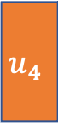

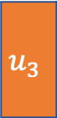
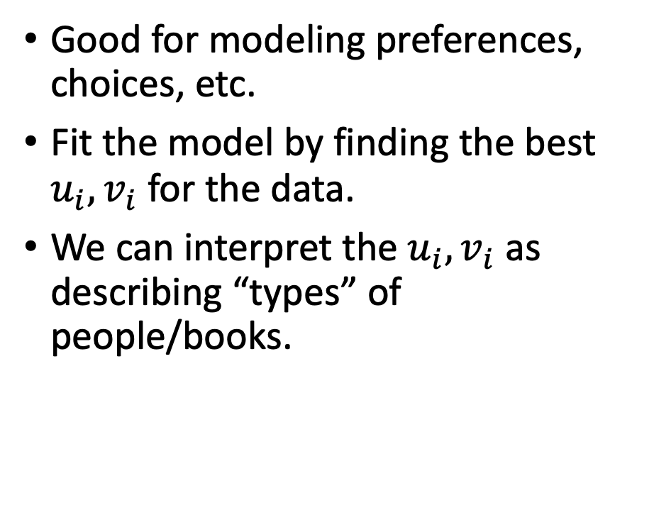

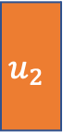

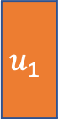

More complicated models... SVD and PCA!
Parameters of the model.
(These are unknown and we need to find them).
$$u_{1}$$
$$u_{2}$$
$$u_{3}$$
$$u_{4}$$
Good for modeling preferences, choices, etc.
Fit the model by finding the best $u_{i}, v_{i}$ for the data.
We can interpret the $u_{i}, v_{i}$ as describing “types” of people/books.
-5 | -4 | 3 | 5
0 | -1 | 5 | 4
5 | 4 | -4.5 | -5
5 | 5 | 0 | 0
1 | 0 | -1 | 0
$$v_{1}$$
$$v_{2}$$
$$v_{3}$$
$$v_{4}$$
$$v_{5}$$
Data (this is what we observe)

Slide 72













Even more complicated models... Neural Networks!
$$σ$$
$$σ$$
$$σ$$
$$σ$$
$$σ$$
The model: brain-inspired “network of neurons.”
To fit the model, find the best weights to describe the data.
Difficulties:
Non-convexity
Overparameterization
Need lots of representative training data
Many open questions!
Work very well for prediction, hard to interpret...
But we can use them to predict things that we can interpret, or as a part of a larger more interpretable model.
$$σ$$
$$σ$$
$$Output_{j}$$
$$σ$$
$$σ$$
$$σ$$
$$Input_{j}$$
I can do a better job than you!
Detain the AI!
ML “judge”
Human judge

Slide 73

Dealing with Data
Regulating
When dealing with data, we also need to think about how we (or governments or companies) collect, process, and disseminate that data.
Different frameworks in different countries
E.g., GDPR in the EU vs [basically no regulations on private companies] in the US
Trade-offs: Privacy vs. Better Service/Public Goods
What do we even mean by privacy?
“Anonymization” is typically very non-private
Current popular notion: differential privacy
$50K + noise...
$49.9K + noise...
World 1: Rabbit is in the database
$49,851
$50,026
World 2: Rabbit isn’t in the database

Slide 74
Today: Text as (interpretable) Data
Neural Networks/LLMs are great at text (e.g., ChatGPT), but not so interpretable.
However, there are some interpretable things we can do with text!
Regression/PCA with expert-defined linguistic features
Bigrams and regularization
Word Embeddings

Slide 75
Take-aways from the whole course
Data is all over the place.
There are lots of things we can do with it.
Observational comparisons
...
Regressions
...
Throw it into a neural network
But don’t stop there!
How do we interpret the numbers we get out of those things?
Do we think this is telling us something causal? Or just a correlation?
How should we update our actions/beliefs, if at all, based on these results?
These things are (comparatively) easy.
That is, the math might be hard, but there are software packages to do most of them for you.
These things are really hard.

Slide 76
Thanks for a fantastic quarter!
We had so much fun (and learned a lot) teaching this course!
We’re excited to learn even more from your presentations next week ☺

